Slide 9
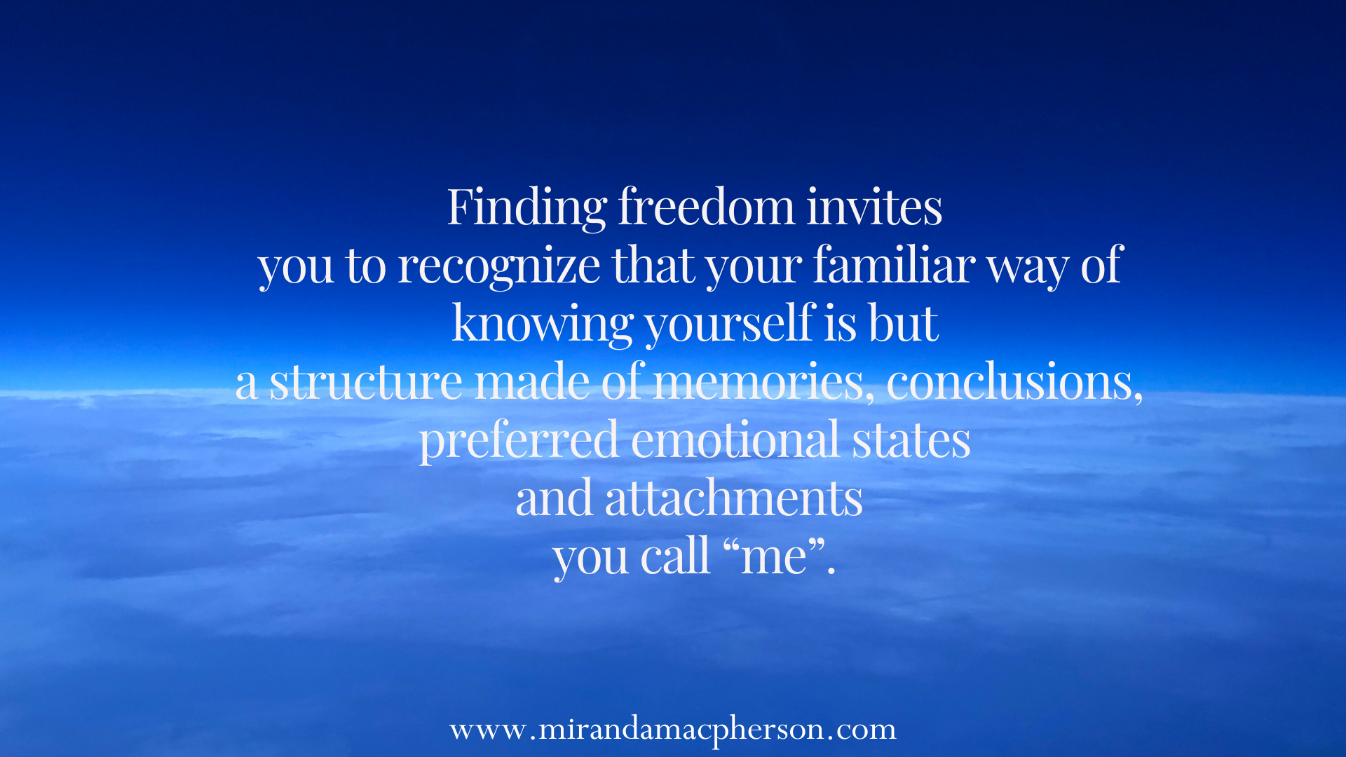

Slide 13
What’s it like if you….
OPEN
SOFTEN
ALLOW
your direct experience
to be exactly as it is?

Slide 14
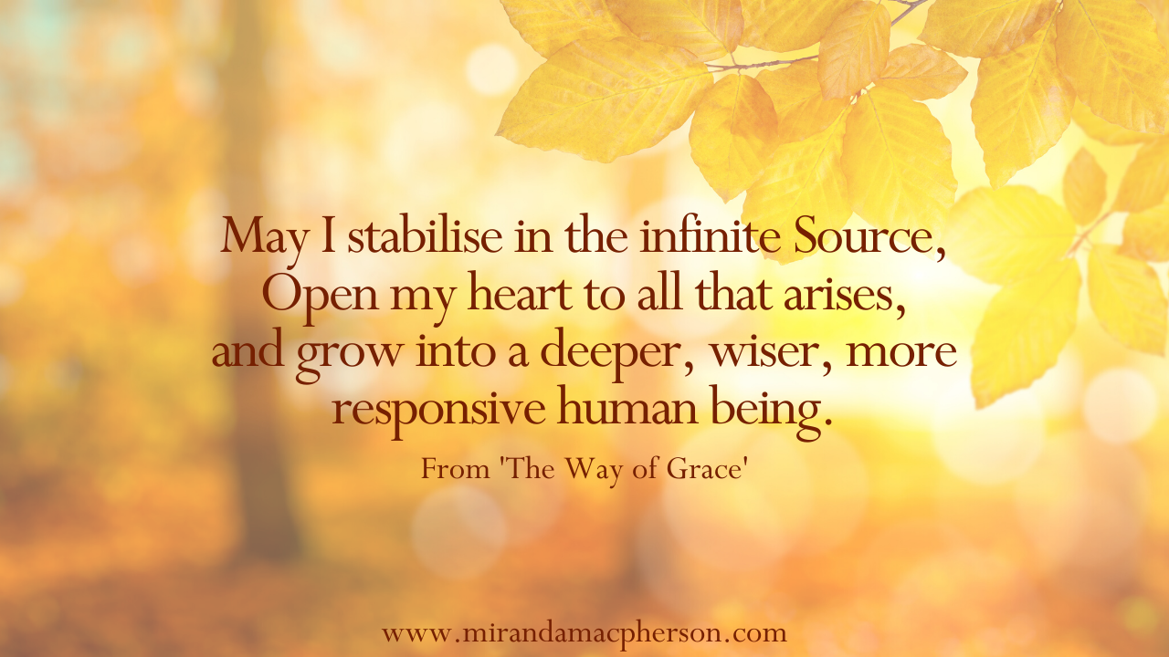

Slide 15
Something precious is revealed as you are lifted out of stress and struggle.
You are part of this Grace.
You are its embodiment, always and forever.
As you keep returning the Divine gaze, you become its reflection.

Slide 18
Consider all the pain and all the pleasure
You have ever experienced
As waves on a very deep ocean which you are.
From the depths, witness those waves,
Rolling along so bravely, always changing,
Beautiful in their self-sustaining power.
Marvel that once, you identified with
Only the surface of this ocean.
Now embrace the waves, depths, undersea mountains,
Out to the farthest shore.
Lorin Roche, The Radiance Sutras

